Slide 1

University Database Management System
By: Cameron Steeves and Faraz Hussain

Slide 2
Our Goal and Project Overview
Our goal for this project is to design and implement a relational database system that simulates a university management system, such as managing student and instructor data, managing course enrollment, etc.
Key components for our project include:
ER Diagram
DDL statements
Sample Data
JDBC Integration
Command-Line Interface (CLI)

Slide 3

Technologies Used
Database Technology:
MySQL Server 8.0 (Database Engine)
MySQL Workbench (Database Design)
Programming:
Java 11
JDBC (MySQL Connector/J 9.2.0)
BlueJ IDE
Development Tools:
GitHub (Version Control)
Maven (Dependency Management)
draw.io (ER diagram)

Slide 4
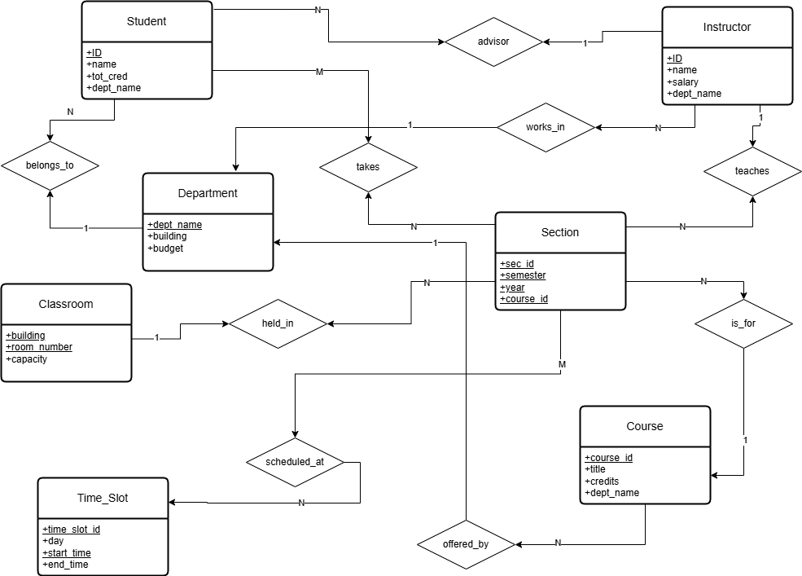
ER Diagram

Slide 5
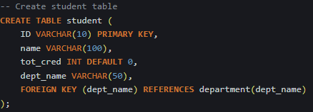
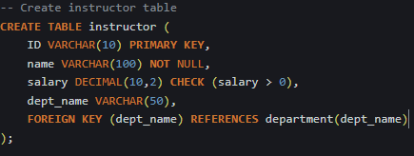
DDL Statements: Entity Tables
Main Entity Objects
department
student
instructor
course
classroom
section
time_slot

Slide 6
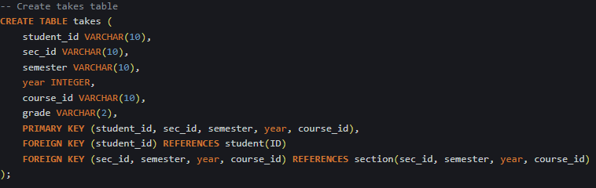
DDL Statements: Relationship Tables
Relationship tables connect our entities and store interaction data:
advisor – links student to their instructor advisor (one-to-one)
teaches – which links instructor to section (many-to-many)
takes – links student to section (many-to-many)
sec_time_slot – links section to time_slot (when the class happens)
sec_class – links sections to classroom (where the class happens)
prereq – links course to its prerequisite course (one-to-many)

Slide 7

DDL Statements in relation to ER Diagram
Department: Stores departments with name, building, and budget.
Student: Links each student to a department (belongs_to).
Instructor: Each instructor is tied to a department (works_in).
Course: Courses are connected to departments (offered_by).
Section: Represents a specific course offering in a semester/year (is_for).
Classroom: Represents room locations with capacity using a composite key.
Time_Slot: Stores when classes can be scheduled (day, time).
Advisor: Links a student to their instructor advisor (one-to-one).
Teaches: Maps instructors to course sections (many-to-many).
Takes: Tracks which students take which sections (with grade).
Held_In: Connects sections to classrooms.
Scheduled_At: Links each section to a specific time slot.

Slide 8
Sample Data Overview
Our sample data is designed to populate the database with realistic entries, facilitating thorough testing and demonstration of the application's capabilities.
Example Entity Insert:
Example Relationship Insert:

Slide 9
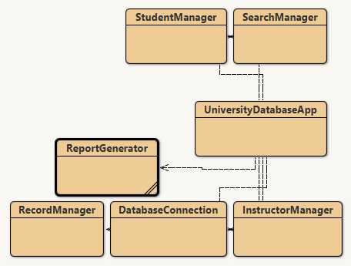
JDBC and Java Code Rundown
Main Entry Point: UniversityDatabaseApp class
Application Features:
Object-oriented design with manager classes
DatabseConnection class handles connection library
JDBC Implementation:
Connects to MySQL using DatabaseConnection
Loads database schema from the MySQL JDBC driver
Loads sample data from our sample data SQL file
Reads results using ResultSet and displays the output in the terminal

Slide 10
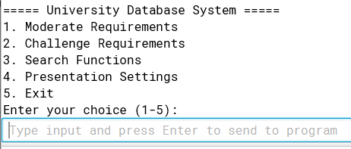
Database Command-Line Interface (CLI)
Overview
Our CLI provides a menu-based navigation system for managing the university database through simple text commands.
Users can perform all CRUD operations, run searches, and generate reports without knowledge of SQL syntax.
Main Menu Structure:
Moderate Requirements: Access tax calculation for instructors and highest grade reports for students.
Challenge Requirements: Perform CRUD operations on students and instructors, including department changes.
Search Functions: Execute complex queries across various database entities.
Presentation Settings: Configure display options for database output.

Slide 11
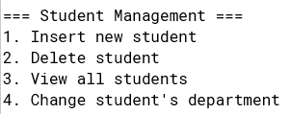
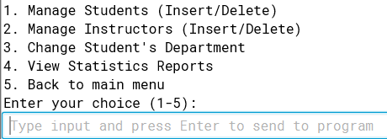
Application Features: CRUD Operations
Our BlueJ-based application features a CRUD interface, enabling efficient management and a clean navigation of university data through a user-friendly menu system.
Create:
Add students, instructors, departments, and courses.
We can also register students for courses with validation.
Read:
View detailed records
Generate reports and search results
Update:
Modify student/instructor data
Change student's department
Delete:
Safely remove entities with checks for related data
String sql = "INSERT INTO department VLAUES (?, ?, ?)";
String deptQuery = "SELECT dept_name FROM department ORDER BY dept_name";

Slide 12
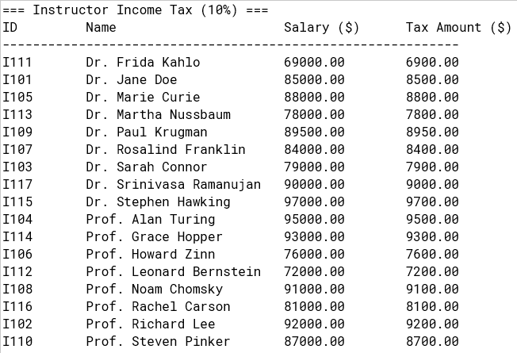
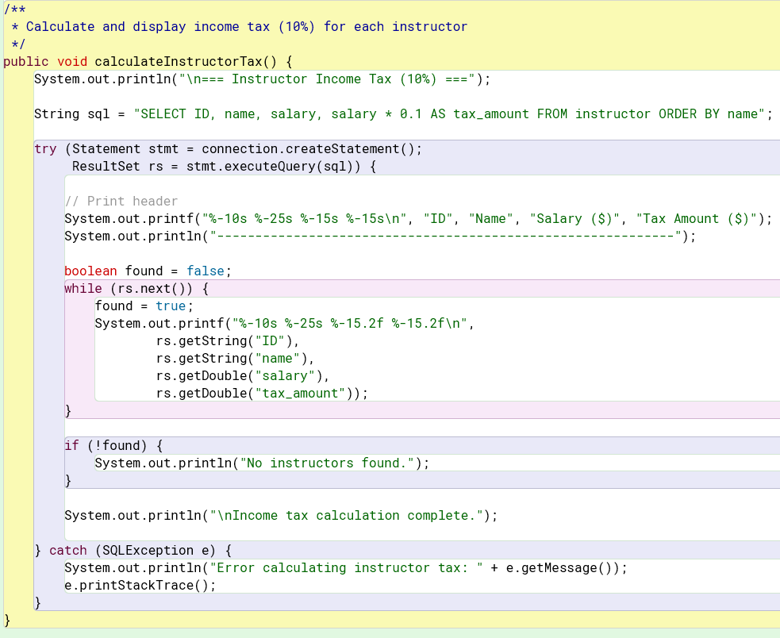
Income Tax Calculation
Run the code and select the following path in the Prompt line:
> Moderate Requirements > Calculate instructor income tax >
It the Displays the Tax amount, Salary, ID, and Name of the instructor as shown on the Screenshot
Java Code and SQL implementation: Calculates the tax by doing it in the SQL query using salary * 0.1 and displays the tax outcome through the CLI.

Slide 13
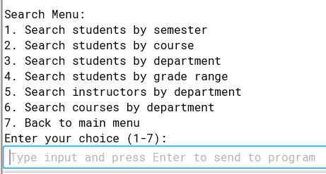
Advanced Search Capabilities
Search Implementation:
Dynamic query construction based on user criteria
Search Categories:
Student searches by ID, name, department, grade, credits
Instructor searches by ID, department, salary range
Course searches by department, credit hours, instructor
Cross-entity search capabilities (e.g., instructors teaching specific courses)

Slide 14
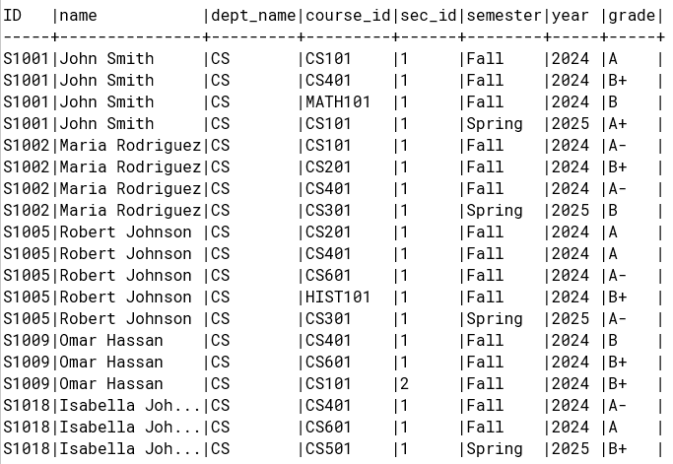
Search Query Example: Students in CS Department
Results are formatted in a tabular layout showing student IDs, names, and associated course information.
Code Highlights:
Enables academic advisors to quickly view all students in a specific department
Facilitates department-based reporting and analysis
Demonstrates the relational capabilities of the database system

Slide 15

Challenges Faced
Technical Challenges:
Setting up the database connection efficiently on different computers
Making sure data stays accurate during updates or changes
Fixing issues that occurred when using different computers when sharing code.
Development Hurdles:
Handling errors when the app couldn’t connect to the database
making sure the database secured a stable connection.
Resolving SQL syntax differences between design and final implementation

Slide 16

Conclusion
Project Achievements:
Successfully implemented a comprehensive university database system
Created an intuitive interface for database operations
Demonstrated practical application of database design principles
Applied JDBC connectivity with proper resource management
Things we can enhance on:
Web-based user interface
Adanced reporting with data visualization

